Slide 1
UNIT I DEMAND ANALYSIS

Slide 2
Meaning of Demand
Demand for commodity implies ;
Desire to acquire it
Willingness to pay for it
Ability to pay for it
Demand = Desire + Ability to Pay + Willingness to Pay
Demand for a particular commodity refers to the commodity which an individual consumer or household is willing to purchase per unit of time at a particular price.

Slide 3
Types of Demand
Individual and Market demand
The quantity of a commodity an individual is willing and able to purchase at a particular price, during a specific time period, given his/her money income, his/her taste, and prices of other commodities, such as substitutes and complements, is referred to as the individual demand for the commodity.
The total quantity which all the consumers of the commodity are willing and able to purchase at a given price per time unit, given their money incomes, their tastes, and prices of other commodities, is referred to as the market demand for the commodity.

Slide 4
Demand for firm’s and industry product
The quantity of a firm’s product that can be sold at a given price over time is known as the demand for the firm’s product.
The sum of demand for the products of all firms in the industry is referred to as the market demand or industry demand for the product.

Slide 5
Autonomous and Derived demand
An autonomous demand or direct demand for a commodity is one that arises on its own out of a natural desire to consume or possess a commodity. This type of demand is independent of the demand for other commodities.
The demand for a commodity which arises from the demand for other commodities, called ‘parent products’ is called derived demand. Demand for land, fertilizers and agricultural tools, is a derived demand because these commodities are demanded due to demand for food.

Slide 6
Demand for durable and non-durable goods
Durable goods are those goods for which the total utility or usefulness is not exhaustible in the short-run use. Such goods can be used repeatedly over a period of time.
The demand for non-durable goods depends largely on their current prices, consumers’ income, and fashion. It is also subject to frequent changes.

Slide 7
Short-term and long-term demand
Short-term demand refers to the demand for goods over a short period.
The long-term demand refers to the demand which exists over a long period of time

Slide 8
Law of Demand
Law of demand expresses the relationship between the Quantity demanded and the Price of the commodity.
The law of demands states that, “Ceteris Paribus, (other things remaining constant) the lower the price of a commodity the larger the quantity demanded of it and vice versa.”
In simple terms other things remain constant, if the price of the commodity increases, the demand will decrease and if the price of the commodity decreases, the demand will increase.
The quantity of a good that consumers are willing and able to buy per period relates inversely, or negatively, to the price, other things constant.

Slide 9
Law of Demand
Part 1. As PRICE increases, DEMAND decreases
Part 2. As PRICE decreases, DEMAND increases
Price goes up
Demand goes down
THEN
Demand goes up
Price goes down
THEN

Slide 10
Demand Analysis
Demand Schedule
A demand schedule is a numerical tabulation that shows the quantity
demanded of a commodity at different prices.
The demand schedule may be of 2 types :
Individual demand Schedule
Market demand Schedule.

Slide 11
Catherine’s Demand Schedule and Demand Curve: Example
Price of Ice-cream cone | Q_{D} Cones demanded
$0.00 0.50 1.00 1.50 2.00 2.50 3.00 | 12 10 8 6 4 2 0
Price of
Ice-Cream
Cones
1. A decrease
in price . . .
$3.00
2.50
2. . . . increases quantity
of cones demanded.
2.00
1.50
1.00
Demand curve
The demand curve illustrates how the quantity demanded of the good changes as its price varies. Because a lower price increases the quantity demanded, the demand curve slopes downward.
0.50
0
1
2
3
4
5
6
7
8
9
10
11
12
Quantity of Ice-Cream Cones

Slide 12
Demand (the Buyers)
Market vs. Individual Demand
Individual demand is a function of income, prices of related goods, expectations and tastes
Market demand is the sum of individual demands
Increases (decreases) in aggregate demand move the demand curve to the right (left)

Slide 13
Market Demand as the Sum of Individual Demands (Demand Schedule)
Price of ice-cream cone | Catherine |  | Nicholas |  | Market
$0.00 0.50 1.00 1.50 2.00 2.50 3.00 | 12 10 8 6 4 2 0 | + | 7 6 5 4 3 2 1 | = | 19 16 13 10 7 4 1
The quantity demanded in a market is the sum of the quantities demanded by all the
buyers at each price: e.g., If price = $2.00, then Catherine demands 4 ice-cream
cones, and Nicholas demands 3 ice-cream cones. The total quantity demanded in the
market at this price is 7 cones.
13

Slide 14
Market Demand as the Sum of Individual Demands
Catherine’s
demand
+
Nicholas’s
demand
=
Market
demand
Price of
Ice
Cream
Cones
Price of
Ice
Cream
Cones
Price of
Ice
Cream
Cones
$3.00
D_{Catherine}
$3.00
$3.00
2.50
D_{Nicholas}
2.50
2.50
2.00
2.00
2.00
1.50
1.50
1.50
D_{Market}
1.00
1.00
1.00
0.50
0.50
0.50
0
1
2
3
4
5
6
7
8
9
10
11
12
0
1
2
3
4
5
6
7
0
2
4
6
8
10
12
14
16
18
Quantity of Ice-Cream Cones
Quantity of
Ice-Cream Cones
Quantity of Ice-Cream Cones
14

Slide 15
Demand Analysis- Assumptions
No change in taste and preference.
Income of the consumer is constant.
No change in customs, habit, quality of goods.
No change in substitute products, related products and the price of the product.
No complementary goods.

Slide 16
Demand Function
A Mathematical relationship between quantity demanded of the commodity and its determinants is known as Demand Function.
When this relationship relates to the demand by an individual consumer it is known as Individual demand function and while it relates to the market its known as market demand function.
Individual Demand Function :
Qdx = f (Px, Y, P1……. Pn-1, T, A, Ey. Ep, U)

Slide 17
Market Demand Function
Qdx = f (Px, Y, P1……. Pn-1, T, A, Ey, Ep, P, D, U, P)
P = Population
D = Distribution of consumers.

Slide 18
Demand Analysis
Causes of downward sloping of Demand Curve
According to the law of demand there exists a opposite relationship between the PRICE and the QUANTITY DEMANDED, and that is why demand curve is downward sloping
Let the linear form of demand curve :
P = a + bq, where a, q constant and b < 0, i.e. dp/dq = b < 0
(Assumption), so slope of the demand curve is negative.
The various reasons for this downwards sloping of demand curves are as follows:
Law of Diminishing Marginal Utility and Equi-Marginal utility.
Price Effect.
Income Effect.
Substitution Effect.
Different Uses ( eg: Electricity)

Slide 19
Demand Analysis
Factors Determining Demand:
General Factors:
Price of the product
Taste and Preference
Income
Prices of the related goods
Additional Factors: (Luxury Goods & Durables)
Consumer’s Expectation of future price.
Consumer’s Expectation of future income.
Additional Factors:( Market Demand)
Population
Social, Economic & Demographic distribution of Consumer’s.

Slide 20
Exceptions to Law of Demand
1) Giffen Goods:
Giffen goods are the inferior goods whose demand increases with the increase in its prices.
There are several inferior commodities, much cheaper than the superior substitutes often consumed by the poor households as an essential commodity.
Whenever the price of the Giffen goods increases its quantity demanded also increases because, with an increase in the price, and the income remaining the same, the poor people cut the consumption of superior substitute and buy more quantities of Giffen goods to meet their basic needs.
Eg: Barley, Bajra, Potatoes( this is classic example during Irish Famine- 1845-1849).

Slide 21
Exceptions to Law of Demand
2) Veblen Goods
Another exception to the law of demand is given by the economist Thorstein Veblen, who proposed the concept of “Conspicuous Consumption.”
According to Veblen, there are a certain group of people who measure the utility of the commodity purely by its price, which means, they think that higher priced goods and services derive more utility than the lesser priced commodities.
Eg: Diamond, Platinum etc.

Slide 22
Contd..
3) Expectation of Price Change in Future:
When the consumer expects that the price of a commodity is likely to further increase in the future, then he will buy more of it despite its increased price in order to escape himself from the pinch of much higher price in the future.
On the other hand, if the consumer expects the price of the commodity to further fall in the future, then he will likely postpone his purchase despite less price of the commodity in order to avail the benefits of much lower prices in the future.

Slide 23
Contd..
4) Ignorance: Often people are misconceived as high-priced commodities are better than the low-priced commodities and rest their purchase decision on such a notion. They buy those commodities whose price are relatively higher than the substitutes.
5) Emergencies: During emergencies such as war, natural calamity- flood, drought, earthquake, etc., the law of demand becomes ineffective. In such situations, people often fear the shortage of the essentials and hence demand more goods and services even at higher prices
6) Change in fashion and Tastes & Preferences: The change in fashion trend and tastes and preferences of the consumers negates the effect of law of demand. The consumer tends to buy those commodities which are very much ‘in’ in the market even at higher prices.

Slide 24
Contd..
7) Bandwagon Effect: This is the most common type of exception to the law of demand wherein the consumer tries to purchase those commodities which are bought by his friends, relatives or neighbors. Here, the person tries to emulate the buying behavior and patterns of the group to which he belongs irrespective of the price of the commodity.
For example, if the majority of group members have smart phones then the consumer will also demand for the smartphone even if the prices are high.

Slide 25
Change in Demand and Shift in demand
Due to changes in price of the commodity
Expansion
Contraction
Due to changes in factors other than price/ Shift in Demand
Increase
Decrease

Slide 26
Expansion of Demand
Decrease in Price
Price | Quantity
12,000 | 15 unit
8,000 | 20 unit
Price of good
E1
P-12,000
P-8,000
E2
Q -15
Q -20
Quantity demanded
An expansion of demand denote E1 to E2
is a rise in the quantity demanded because the price has changed , other factors remaining the same (ceteris paribus).

Slide 27
Contraction of Demand
Increase in the price
Price | Quantity
12,000 | 15 unit
15,000 | 10 unit
E2
P-15,000
E1
P-12,000
Price of good
Q -10
Q -15
Quantity demanded
A CONTRACTION of demand is the fall in the quantity demanded because the price has changed , other factors remaining the same. (from E1 to E2)

Slide 28
Shift in Demand: Demand Curve Shifters
0
The demand curve shows how price affects quantity demanded, other things being equal.
These “other things” are non-price determinants of demand (i.e., things that determine buyers’ demand for a good, other than the good’s price).
Changes in them shift the D curve…
Notes:
28

Slide 29
Demand Curve Shifters: Number of Buyers
0
Increase in number of buyers increases quantity demanded at each price, shifts D curve to the right.
Notes:
29
Income is the first demand shifter discussed in this chapter of the textbook. I chose to start with a different one (number of buyers), for the following reason:
In discussing the impact of changes in income on the demand curve, the textbook also introduces the concept of normal goods and inferior goods. Students may find it easier to learn about curve shifts if the presentation focuses solely on a curve shift (at least initially) without simultaneously introducing other concepts.
If you wish to present the demand shifters in the same order as they appear in the book, simply reorder the slides in this presentation.

Slide 30
Demand Curve Shifters: Number of Buyers
0
P
Suppose the number of buyers increases.
Then, at each P, Q^{d} will increase (by 5 in this example).
Q
Notes:
30
Beginning economics students often have trouble understanding the difference between a movement along the curve and a shift in the curve. Here, the animation has been carefully designed to help students see that a shift in the curve results from an increase in quantity at each price.
(A more realistic scenario would involve a non-parallel shift, where the horizontal distance of the shift would be greater for lower prices than higher ones. However, to remain consistent with the textbook, and to keep things simple, this slide shows a parallel shift.)

Slide 31
Demand Curve Shifters: Income
0
Demand for a normal good is positively related to income.
Increase in income causes increase in quantity demanded at each price, shifts D curve to the right.
(Demand for an inferior good is negatively related to income. An increase in income shifts D curves for inferior goods to the left.)
Notes:
31

Slide 32
Elasticity of Demand

Slide 33
Contents
Elasticity of demand
Method and measurement of demand
Types of elasticity of demand

Slide 34
Elasticity of Demand
Elasticity: a measure of the responsiveness of quantity demanded to one of its determinants.
Types of Elasticity of Demand:
1. Price Elasticity of Demand:
Price elasticity of demand measures how much the quantity demanded responds to a change in price.
computed as the percentage change in quantity demanded divided by the percentage change in price

Slide 35
Price Elasticity of Demand
0
Price elasticity of demand
Percentage change in Q^{d}
=
Percentage change in P
P
Along a D curve, P and Q move in opposite directions, which would make price elasticity negative.
We will drop the minus sign and report all price elasticities as positive numbers.
P₂
P₁
D
Q
Q₂
Q₁
Notes:
It might be worth explaining to your students that “P and Q move in opposite directions” means that the percentage change in Q and the percentage change in P will have opposite signs, thus implying a negative price elasticity.
To be consistent with the text, the last statement in the green box says that we will report all price elasticities as positive numbers. It might be slightly more accurate to say that we will report all elasticities as non-negative numbers: we want to allow for the (admittedly rare) case of zero elasticity.

Slide 36
Calculating Percentage Changes
0
Standard method of computing the percentage (%) change:
Demand for your websites
end value – start value
P
x 100%
start value
B
$250
A
Going from A to B, the % change in P equals
$200
D
($250–$200)/$200 = 25%
Q
8
12

Slide 37
Calculating Percentage Changes
0
Problem:
The standard method gives different answers depending on where you start.
Demand for your websites
P
From A to B, P rises 25%, Q falls 33%, elasticity = 33/25 = 1.33
From B to A, P falls 20%, Q rises 50%, elasticity = 50/20 = 2.50
B
$250
A
$200
D
Q
8
12

Slide 38
Calculating Percentage Changes
0
So, we instead use the midpoint method:
end value – start value
x 100%
midpoint
The midpoint is the number halfway between the start & end values, also the average of those values.
It doesn’t matter which value you use as the “start” and which as the “end” – you get the same answer either way!

Slide 39
Calculating Percentage Changes
0
Using the midpoint method, the % change in P equals
$250 – $200
x 100%
= 22.2%
$225
The % change in Q equals
12 – 8
x 100%
= 40.0%
10
The price elasticity of demand equals
40/22.2 = 1.8
Notes:
These calculations are based on the example shown a few slides back: points A and B on the website demand curve.

Slide 40
Types of Price Elasticity of Demand
1. Perfectly Inelastic Demand
2. Inelastic Demand
3. Unitary elastic Demand
4. Elastic Demand
5. Perfectly Elastic Demand

Slide 41
Perfectly Inelastic Demand - Elasticity equals 0
Price
Demand
1. An
increase
in price...
$5
4
100
Quantity
2. ...leaves the quantity demanded unchanged.
Notes:
8
7

Slide 42
Inelastic Demand - Elasticity is less than 1
Price
1. A 25%
increase
in price...
$5
4
Demand
90
100
Quantity
2. ...leads to a 10% decrease in quantity.
Notes:
8
7

Slide 43
Unitary Elastic Demand - Elasticity equals 1
Price
1. A 25%
increase
in price...
$5
4
Demand
75
100
Quantity
2. ...leads to a 25% decrease in quantity.
Notes:
8
7

Slide 44
Elastic Demand - Elasticity is greater than 1
Price
$5
1. A 25%
increase
in price...
4
Demand
50
100
Quantity
2. ...leads to a 50% decrease in quantity.
Notes:
8
7

Slide 45
Perfectly Elastic Demand - Elasticity equals infinity
Price
1. At any price
above $4, quantity
demanded is zero.
$4
Demand
2. At exactly $4,
consumers will
buy any quantity.
Quantity
3. At a price below $4,
quantity demanded is infinite.
Notes:
8
7

Slide 46
Determinants of Price Elasticity of Demand
Necessities versus Luxuries
Availability of Close Substitutes
Definition of the Market
Time Horizon
Notes:
13
8

Slide 47
Determinants of Price Elasticity of Demand
Demand tends to be more inelastic
If the good is a necessity.
If the time period is shorter.
The smaller the number of close substitutes.
The more broadly defined the market.

Slide 48
Determinants of Price Elasticity of Demand
Demand tends to be more elastic :
if the good is a luxury.
the longer the time period.
the larger the number of close substitutes.
the more narrowly defined the market.
Notes:
13
8

Slide 49
Elasticity and Total Revenue
Total revenue is the amount paid by buyers and received by sellers of a good.
Computed as the price of the good times the quantity sold.
TR = P x Q
Notes:
21
15

Slide 50
Elasticity and Total Revenue
Price
$4
P x Q = $400
P
(total revenue)
Demand
0
100
Quantity
Q
Notes:
22
15

Slide 51
Price Elasticity and Total Revenue
0
Continuing our scenario, if you raise your price from $200 to $250, would your revenue rise or fall?
Revenue = P x Q
A price increase has two effects on revenue:
Higher P means more revenue on each unit you sell.
But you sell fewer units (lower Q), due to Law of Demand.
Which of these two effects is bigger? It depends on the price elasticity of demand.
Notes:
We return to our scenario. It’s not hard for students to imagine being in this position – running their own business and trying to decide whether to raise the price.
To most of your students, it should be clear that making the best possible decision would require information about the likely effects of the price increase on revenue. That is why elasticity is so helpful, as we will now see….

Slide 52
Price Elasticity and Total Revenue
0
Price elasticity of demand
Percentage change in Q
=
Percentage change in P
Revenue = P x Q
If demand is elastic, then
price elast. of demand > 1
% change in Q > % change in P
The fall in revenue from lower Q is greater than the increase in revenue from higher P, so revenue falls.

Slide 53
Income Elasticity of Demand
Income elasticity of demand measures how much the quantity demanded of a good responds to a change in consumers’ income.
It is computed as the percentage change in the quantity demanded divided by the percentage change in income.
Notes:
29
19

Slide 54
Computing Income Elasticity
Percentage Change
in Quantity Demanded
Income Elasticity
of Demand
=
Percentage Change
in Income
Notes:
31
20

Slide 55
Income Elasticity - Types of Goods
Normal Goods
Income Elasticity is positive.
Inferior Goods
Income Elasticity is negative.
Higher income raises the quantity demanded for normal goods but lowers the quantity demanded for inferior goods.
Notes:
32
21

Slide 56
Cross Price Elasticity of Demand
The cross-price elasticity of demand measures the response of demand for one good to changes in the price of another good.
Cross-price elasticity of demand
% change in Q^{d} for good 1
=
% change in price of good 2
For substitutes, cross-price elasticity > 0 E.g., an increase in price of tea causes an increase in demand for coffee.
For complements, cross-price elasticity < 0 E.g., an increase in price of computers causes decrease in demand for software.

Slide 57
Promotional Elasticity of Demand (Advertisement Elasticity)
The advertisement elasticity of demand measures the responsiveness of the quantity demanded through the changes in the advertisement expenditure. (assuming other factors unchanged).
It can be calculated through the following formula
Promotional elasticity of demand
% change in Q^{d}
=
% change in advertisement expenditure

Slide 58
Demand Forecasting
“Prediction is very difficult,
especially if it's about the future.”
(Niels Bohr)

Slide 59
What is forecasting?
Forecasting is a tool used for predicting
future demand based on
past demand information.
Is essentially a judgement of future probabilities of the future demand.
Is an attempt to predict the future demand based on past data under conditions of uncertainty.
Prediction or estimation of a future situation, under given conditions

Slide 60
Why is forecasting important?
Demand for products and services is usually uncertain.
Forecasting can be used for…
Strategic planning (long range planning)
Finance and accounting (budgets and cost controls)
Marketing (future sales, new products)
Production and operations

Slide 61
What is forecasting all about?
Demand for Mercedes E Class
We try to predict the future by looking back at the past
Predicted demand looking back six months
Time
Jan
Feb
Mar
Apr
May
Jun
Jul
Aug
Actual demand (past sales)
Predicted demand

Slide 62
Some general characteristics of forecasts
Forecasts are more accurate for groups or families of items
Forecasts are more accurate for shorter time periods
Every forecast should include an error estimate
Forecasts are no substitute for calculated demand.

Slide 63
Classification of Demand Forecasts
Active vs passive forecasting
Active forecasting is a method of forecasting the demand on the consideration that a firm is likely to initiate some action like changes in product quality, size, price etc.
Passive forecasting based on the assumption that the same product is being offered without any changes.
Short-run vs long run forecasting
Short-run forecasting normally extends up to one year. These forecasts are useful for product scheduling, inventory planning, and mobilization of working capital etc.
Long-run forecasts extend beyond one year. They are helpful in capital budgeting, product diversification, personnel recruitment etc.

Slide 64
Contd..
Company forecasting vs Industry forecasting
Forecasting the demand for the products of a particular firm is company forecasting.
These are firm specific and designed to serve the individual firms in planning their policies.
Industry forecasting forecasts the demand for the products of the industry as a whole.
The association of manufacturers or trade associations undertake them and serve the needs of all the firms in the industry.

Slide 65
Contd…
Durable Vs. Perishable goods
Durable goods forecasting involves forecasting of goods which are durable in nature.
Eg: furniture, electronics products etc.
Perishable goods forecasting is for those goods which are perishable.
Eg: vegetables, fruits etc.

Slide 66
Contd..
Micro level forecasting vs Macro level forecasting
Micro level forecasting may take the form of company forecasting or industry forecasting.
Macro level forecasting on the other hand is concerned with forecasting general economic environment and business conditions in the country as a whole.
The national income growth rates, production indices, price indices provide useful insights into the future demand for most of the commodities. Governmental organizations provide the base data to forecast the demand.

Slide 67
Steps in Demand Forecasting
Identification of the objective
Identify Nature of the product
Determination of demand
Choice of appropriate method
Analysis

Slide 68
Key issues in forecasting
A forecast is only as good as the information included in the forecast (past data)
History is not a perfect predictor of the future (i.e.: there is no such thing as a perfect forecast)
Forecasting is based on the assumption that the past predicts the future! When forecasting, think carefully whether or not the past is strongly related to what you expect to see in the future…

Slide 69
Example: Mercedes E-class vs. M-class Sales
Month | E-class Sales | M-class Sales
Jan | 23,345 | -
Feb | 22,034 | -
Mar | 21,453 | -
Apr | 24,897 | -
May | 23,561 | -
Jun | 22,684 | -
Jul | ? | ?
Question: Can we predict the new model M-class sales based on the data in the the table?
Answer: Maybe... We need to consider how much the two markets have in common

Slide 70
What should we consider when looking at
past demand data?
Data = historic pattern + random variation
Trends
Seasonality
Cyclical elements
Autocorrelation
Random variation

Slide 71
Some Important Questions
What is the purpose of the forecast?
Which systems will use the forecast?
How important is the past in estimating the future?
Answers will help determine time horizons, techniques, and level of detail for the forecast.

Slide 72
Types of forecasting methods
Qualitative methods
Quantitative methods
Rely on subjective opinions from one or more experts.
Rely on data and analytical techniques.

Slide 73
Qualitative Models
Consumer’s Opinion Survey Method
Expert opinion method or Delphi method
Collective opinion survey or sales force opinion survey method

Slide 74
Qualitative Methods

Slide 75
Consumer's opinion survey
The consumer opinion survey can be either census or sample survey. Where the numbers of buyers are limited, census survey methods hold. In this case, the opinion of the entire universe is obtained.
On the other hand, where the number of buyers is large, universal survey is not feasible; hence, sample survey methods are used.
The sample survey can be either purposive sampling or random sampling based on the nature of the product or the objectives of the survey.
Limitations
consumer opinion surveys are not perfectly reliable
expensive and time-taking.

Slide 76
Expert opinion method or Delphi method
Expert opinion method is a variant of the consumer's opinion survey method. It was also popular as Delphi method and first used by Rand Corporation in USA for predicting the demand under conditions of intractable technological changes. It is used under conditions of nonexistence of data or when a new product is being launched.
The fairest step in this method is the identification of experts and eliciting their opinions about the likely demand for the product. The experts may differ in their views in which case the firm has to pass on the opinions of one expert to the other, of course under strict anonymity and seek their reactions. This exercise should go on until a common line of thinking emerges.
This method will be useful tool of demand forecasting provided the experts did not have biased opinions.

Slide 77
Collective opinion survey or sales force opinion survey method
In this method, the firm will extract the opinions of the sales team, which is on the payrolls of the company about the future demand for the product. The sales personnel are very close to the consumers and dealers. They express their opinions about the future demand for the product.
The opinions so gathered are tabulated and the demand forecasts will be arrived at.
However, care be taken before forming an opinion about the future demand. The opinions of the sales team should not be taken on the face value as an ambitious sales man gives an over estimate of the demand for the product while a sceptic fearing the fixation of higher sales targets always quotes a lesser figure.
This method is an inexpensive but more reliable method of demand forecasting.

Slide 78
End – Use Method
This method is quite useful for industries which are mainly producer’s goods. In this method, the sale of the product under consideration is projected as the basis of demand survey of the industries using this product as an intermediate product.
The end user demand estimation of an intermediate product may involve many final good industries using this product at home and abroad. It helps us to understand inter-industry’ relations. An intermediate product may have many end-users, for e.g., steel can be used for making various types of agricultural and industrial machinery, for construction, for transportation, etc.
It may have demand both in the domestic market as well as the international market. Thus, end – use demand estimation of an intermediate product may involve many final goods ’ industries using this product, at home and in abroad.
After we know the demand for final consumption of goods including their exports, we can estimate the demand for the product which is used as intermediate goods in the production of these final goods with the help of input – output coefficients.

Slide 79
Quantitative Methods
1.Statistical Methods
Trend Projection
Simple Moving Average
Weighted moving Average
Regression Method
2. Barometric Method

Slide 80
How should we pick our forecasting model?
Data availability
Time horizon for the forecast
Required accuracy
Required Resources

Slide 81
Time Series: Moving average
The moving average model uses the last t periods in order to predict demand in period t+1.
There can be two types of moving average models: simple moving average and weighted moving average
The moving average model assumption is that the most accurate prediction of future demand is a simple (linear) combination of past demand.

Slide 82
Time series: simple moving average
In the simple moving average models the forecast value is
A_{t} + A_{t-1} + … + A_{t-n}
F_{t+1} =
n
t is the current period.
F_{t+1} is the forecast for next period
n is the forecasting horizon (how far back we look),
A is the actual sales figure from each period.

Slide 83
Example: forecasting sales at Kroger
Kroger sells (among other stuff) bottled water
What will the sales be for July?
Month | Bottles
Jan | 1,325
Feb | 1,353
Mar | 1,305
Apr | 1,275
May | 1,210
Jun | 1,195
Jul | ?

Slide 84
What if we use a 3-month simple moving average?
A_{Jun} + A_{May} + A_{Apr}
F_{Jul} =
= 1,227
3
What if we use a 5-month simple moving average?
A_{Jun} + A_{May} + A_{Apr} + A_{Mar} + A_{Feb}
F_{Jul} =
= 1,268
5

Slide 85
5-month
MA forecast
3-month
MA forecast
What do we observe?
5-month average smoothes data more;
3-month average more responsive

Slide 86
Time series: weighted moving average
We may want to give more importance to some of the data…
F_{t+1} =
w_{t} A_{t} + w_{t-1} A_{t-1} + … + w_{t-n} A_{t-n}
w_{t} + w_{t-1} + … + w_{t-n} = 1
t is the current period.
F_{t+1} is the forecast for next period
n is the forecasting horizon (how far back we look),
A is the actual sales figure from each period.
w is the importance (weight) we give to each period

Slide 87
Why do we need the WMA models?
Because of the ability to give more importance to what happened recently, without losing the impact of the past.
Demand for Mercedes E-class
Actual demand (past sales)
Prediction when using 6-month SMA
Prediction when using 6-months WMA
For a 6-month SMA, attributing equal weights to all past data we miss the downward trend
Time
Jan
Feb
Mar
Apr
May
Jun
Jul
Aug

Slide 88
Example: Kroger sales of bottled water
What will be the sales for July?
Month | Bottles
Jan | 1,325
Feb | 1,353
Mar | 1,305
Apr | 1,275
May | 1,210
Jun | 1,195
Jul | ?

Slide 89
6-month simple moving average…
A_{Jun} + A_{May} + A_{Apr} + A_{Mar} + A_{Feb} + A_{Jan}
F_{Jul} =
= 1,277
6
In other words, because we used equal weights, a slight downward trend that actually exists is not observed…

Slide 90
What if we use a weighted moving average?
Make the weights for the last three months more than the first three months…
 | 6-month SMA | WMA 40% / 60% | WMA 30% / 70% | WMA 20% / 80%
July Forecast | 1,277 | 1,267 | 1,257 | 1,247
The higher the importance we give to recent data, the more we pick up the declining trend in our forecast.

Slide 91
How do we choose weights?
Depending on the importance that we feel past data has
Depending on known seasonality (weights of past data can also be zero).
WMA is better than SMA because of the ability to
vary the weights!

Slide 92
Time Series: Exponential Smoothing (ES)
Main idea: The prediction of the future depends mostly on the most recent observation, and on the error for the latest forecast.
Smoothing constant alpha α
Denotes the importance of the past error

Slide 93
Why use exponential smoothing?
Uses less storage space for data
Extremely accurate
Easy to understand
Little calculation complexity
There are simple accuracy tests

Slide 94
Exponential smoothing: the method
Assume that we are currently in period t. We calculated the forecast for the last period (F_{t-1}) and we know the actual demand last period (A_{t-1}) …
The smoothing constant α expresses how much our forecast will react to observed differences…
If α is low: there is little reaction to differences.
If α is high: there is a lot of reaction to differences.

Slide 95
Example: bottled water at Kroger
Month | Actual | Forecasted
Jan | 1,325 | 1,370
Feb | 1,353 | 1,361
Mar | 1,305 | 1,359
Apr | 1,275 | 1,349
May | 1,210 | 1,334
Jun | ? | 1,309
α = 0.2

Slide 96
Example: bottled water at Kroger
Month | Actual | Forecasted
Jan | 1,325 | 1,370
Feb | 1,353 | 1,334
Mar | 1,305 | 1,349
Apr | 1,275 | 1,314
May | 1,210 | 1,283
Jun | ? | 1,225
α = 0.8

Slide 97
Impact of the smoothing constant

Slide 98
Trend..
What do you think will happen to a moving average or exponential smoothing model when there is a trend in the data?

Slide 99
Impact of trend
Sales
Actual Data
Forecast
Month

Slide 100
Linear regression in forecasting
Linear regression is based on
Fitting a straight line to data
Explaining the change in one variable through changes in other variables.
dependent variable = a + b × (independent variable)
By using linear regression, we are trying to explore which independent variables affect the dependent variable

Slide 101
Example: do people drink more when it’s cold?
Alcohol Sales
Which line best fits the data?
Average Monthly Temperature

Slide 102
The best line is the one that minimizes the error
The predicted line is …
So, the error is …
Where: ε is the error
y is the observed value
Y is the predicted value

Slide 103
Least Squares Method of Linear Regression
The goal of LSM is to minimize the sum of squared errors…

Slide 104
What does that mean?
Alcohol Sales
ε
ε
ε
So LSM tries to minimize the distance between the line and the points!
Average Monthly Temperature

Slide 105
Least Squares Method of Linear Regression
Then the line is defined by

Slide 106
Barometric Methods
The barometric method is based on the approach of developing an index of relevant economic indicators and forecasting the future trends by analyzing the movements in these indicators.
A time-series of several indicators is developed to study the future trend.

Slide 107
Contd..
Leading Series: The leading series is comprised of indicators which move up or down ahead of some other series.
The most common examples of leading indicators are- net business investment index, a new order for durable goods, change in the value of inventories, corporate profits after tax, etc.

Slide 108
Contd..
Coincidental Series: The coincidental series include indicators which move up and down simultaneously with the general level of economic activities.
The examples of coincidental series – the rate of unemployment, the number of employees in the non-agricultural sector, sales recorded by manufacturing, retail, and trading sectors

Slide 109
Contd..
Lagging Series: A series consisting of those indicators, which after some time-lag follows the change. Some of the lagging series are- outstanding loan, labor cost per unit production, lending rate for short-term loans, etc.

Slide 110
Contd..
The only advantage of the barometric method of forecasting is that is helps to overcome the problem of finding the value of an independent variable under regression analysis.
The major limitations of this method are;
First, Often the leading indicator of the variable to be forecasted is difficult to find out or is not easily available.
Secondly, the barometric technique can be used only for a short-term forecasting.

Slide 111
How can we compare across forecasting models?
We need a metric that provides estimation of accuracy
Forecast Error
Errors can be:
biased (consistent)
random
Forecast error = Difference between actual and forecasted value (also known as residual)

Slide 112
Measuring Accuracy: MFE
MFE = Mean Forecast Error (Bias)
It is the average error in the observations
1. A more positive or negative MFE implies worse performance; the forecast is biased.

Slide 113
Measuring Accuracy: MAD
MAD = Mean Absolute Deviation
It is the average absolute error in the observations
1. Higher MAD implies worse performance.
2. If errors are normally distributed, then σ_{ε}=1.25MAD

Slide 114
Key Point
Forecast must be measured for accuracy!
The most common means of doing so is by measuring the either the mean absolute deviation or the standard deviation of the forecast error

Slide 115
Criteria for Good Demand Forecasting
Time frame
Pattern of the data
Cost /economy of forecasting
Accuracy desired
Availability of data
Plausibility/ Ease of understanding
Durability
Flexibility

Slide 116
Supply
0
Supply comes from the behavior of sellers.
The quantity supplied of any good is the amount that sellers are willing and able to sell.
Law of supply: the claim that the quantity supplied of a good rises when the price of the good rises, other things equal

Slide 117
The Supply Schedule
0
Supply schedule: A table that shows the relationship between the price of a good and the quantity supplied.
Example: Firm A supply of X.
Price of X | Quantity of X supplied
$0.00 | 0
1.00 | 3
2.00 | 6
3.00 | 9
4.00 | 12
5.00 | 15
6.00 | 18
Notice that supply schedule obeys the Law of Supply.

Slide 118
Market Supply versus Individual Supply
0
The quantity supplied in the market is the sum of the quantities supplied by all sellers at each price.
Suppose Firm A and Firm B are the only two sellers in this market. (Q^{s} = quantity supplied)
Price
Firm A
Firm B
Market Q^{s}
$0.00
0
+
0
=
0
1.00
3
+
2
=
5
2.00
6
+
4
=
10
3.00
9
+
6
=
15
4.00
12
+
8
=
20
5.00
15
+
10
=
25
6.00
18
+
12
=
30
Notes:
Again, the assumption of only two sellers is a clear violation of perfect competition. However, it’s much easier for students to learn how the market supply curve relates to individual supplies in the two-firm case.

Slide 119
The Market Supply Curve
0
P | Q^{S} (Market)
$0.00 | 0
1.00 | 5
2.00 | 10
3.00 | 15
4.00 | 20
5.00 | 25
6.00 | 30
P
Q

Slide 120

The Law of Supply
The law of supply states that there is a positive relationship between price and quantity of a good supplied.
This means that supply curves typically have a positive slope.

Slide 121
Determinants of Supply
The price of the good or service.
The cost of producing the good, which in turn depends on:
The price of required inputs (labor, capital, and land),
The technologies that can be used to produce the product,
The prices of related products.

Slide 122
The law of supply states that other things being equal, the supply of a commodity extends with a rise in price and contracts with a fall in price. There are however a few exceptions to the law of supply.
1. Exceptions of a fall in price
If the firms anticipate that the price of the product will fall further in future, in order to clear their stocks they may dispose it off at a price that is even lower than the current market price.
2. Sellers who are in need of cash
If the seller is in need of hard cash, he may sell his product at a price which may even be below the market price.

Slide 123
3. When leaving the industry
If the firms want to shut down or close down their business, they may sell their products at a price below their average cost of production.
4. Agricultural output
In agricultural production, natural and seasonal factors play a dominant role. Due to the influence of these constraints supply may not be responsive to price changes
5. Backward sloping supply curve of labor
The rise in the price of a good or service sometimes leads to a fall in its supply. The best example is the supply of labor. A higher wage rate enables the worker to maintain his existing material standard of living with less work, and he may prefer extra leisure to more wages. The supply curve in such a situation will be ‘backward sloping’ SS1 as illustrated in figure.

Slide 124
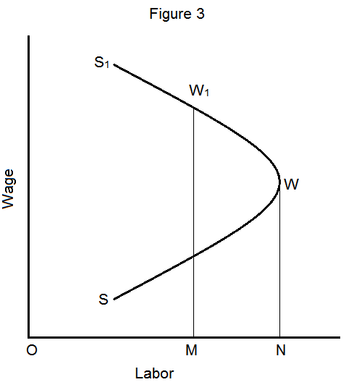

Slide 125
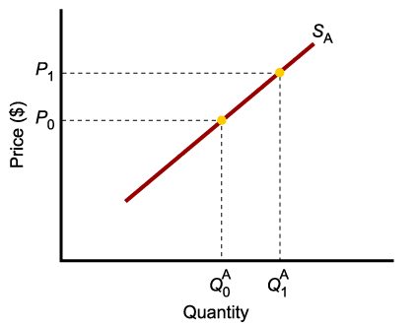
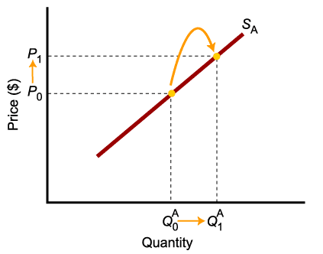
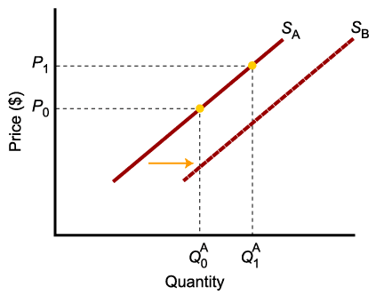
A Change in Supply Versus a Change in Quantity Supplied
A change in supply is not the same as a change in quantity supplied.
In this example, a higher price causes higher quantity supplied, and a move along the supply curve.
In this example, changes in determinants of supply, other than price, cause an increase in supply, or a shift of the entire supply curve, from S_{A} to S_{B}.

Slide 126
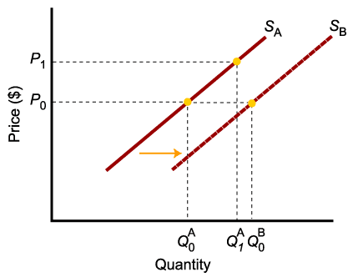
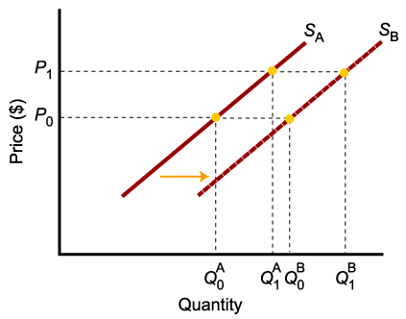
A Change in Supply Versus a Change in Quantity Supplied
When supply shifts to the right, supply increases. This causes quantity supplied to be greater than it was prior to the shift, for each and every price level.

Slide 127

A Change in Supply Versus a Change in Quantity Supplied
To summarize:
Change in price of a good or service
leads to
Change in quantity supplied (Movement along the curve).
Change in costs, input prices, technology, or prices of related goods and services
leads to
Change in supply (Shift of curve).

Slide 128
From Individual Supply to Market Supply
The supply of a good or service can be defined for an individual firm, or for a group of firms that make up a market or an industry.
Market supply is the sum of all the quantities of a good or service supplied per period by all the firms selling in the market for that good or service.

Slide 129
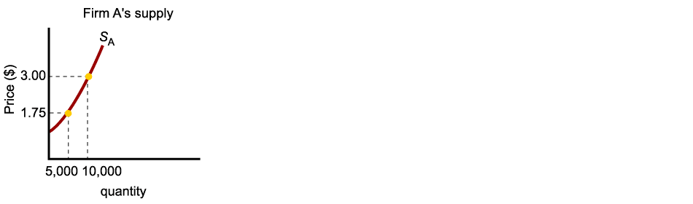
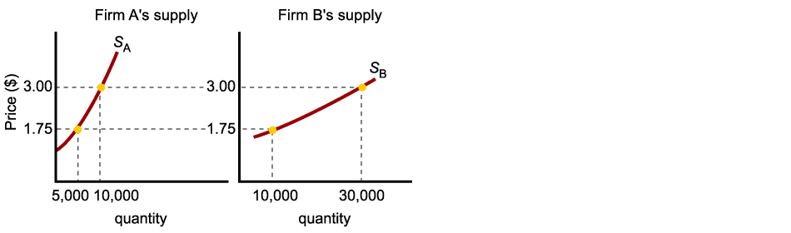
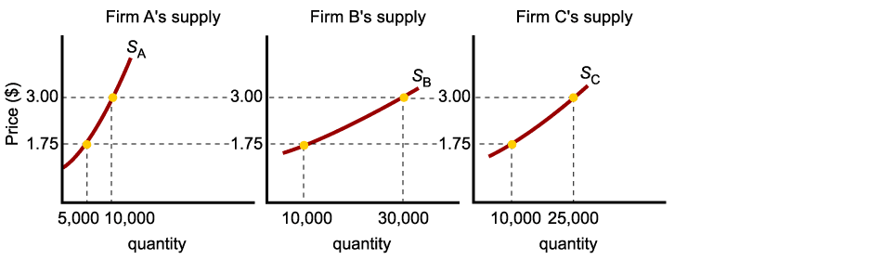
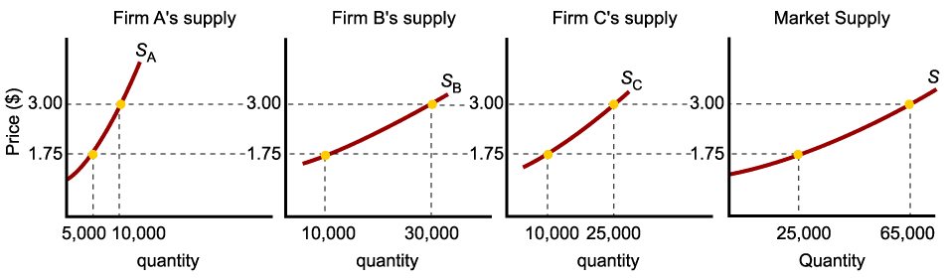
Market Supply
As with market demand, market supply is the horizontal summation of individual firms’ supply curves.

Slide 130
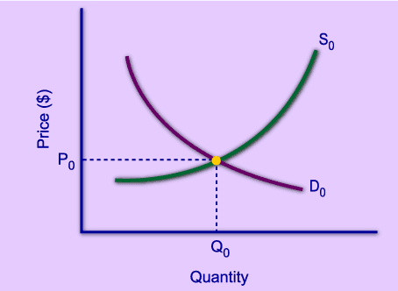
Market Equilibrium
The operation of the market depends on the interaction between buyers and sellers.
An equilibrium is the condition that exists when quantity supplied and quantity demanded are equal.
At equilibrium, there is no tendency for the market price to change.

Slide 131
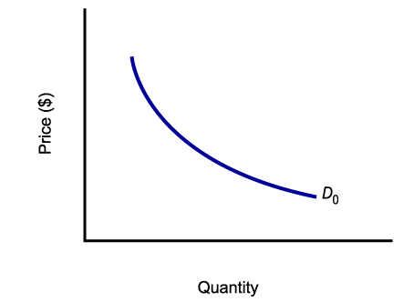
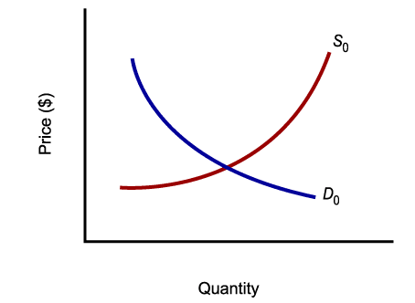
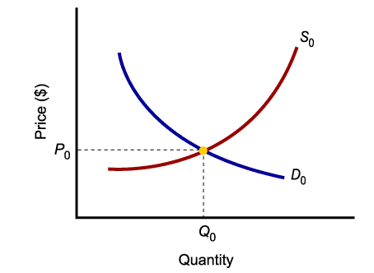
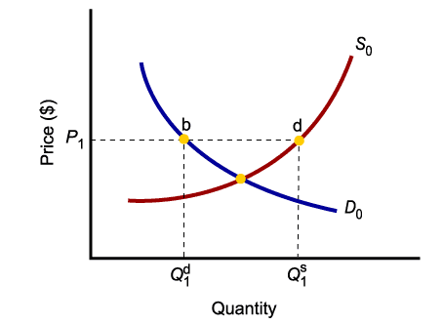
Market Equilibrium
Only in equilibrium is quantity supplied equal to quantity demanded.
At any price level other than P₀, the wishes of buyers and sellers do not coincide.

Slide 132
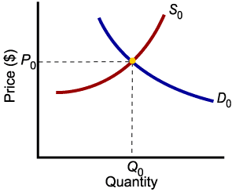
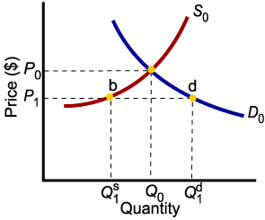
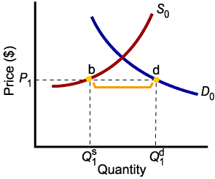
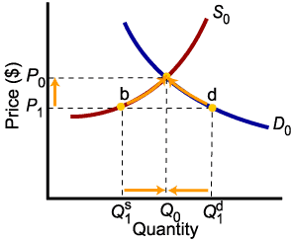
Market Disequilibria
Excess demand, or shortage, is the condition that exists when quantity demanded exceeds quantity supplied at the current price.
When quantity demanded exceeds quantity supplied, price tends to rise until equilibrium is restored.

Slide 133
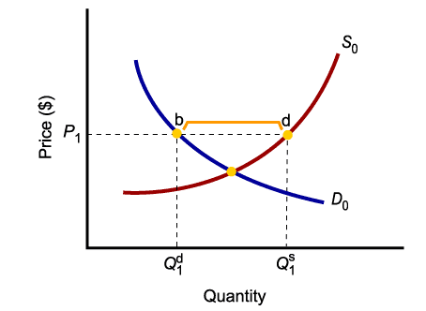
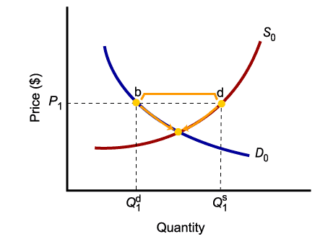
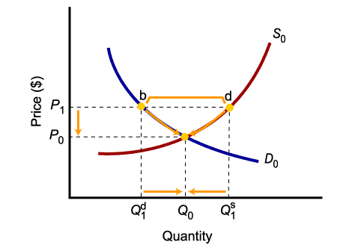
Market Disequilibria
Excess supply, or surplus, is the condition that exists when quantity supplied exceeds quantity demanded at the current price.
When quantity supplied exceeds quantity demanded, price tends to fall until equilibrium is restored.

Slide 134
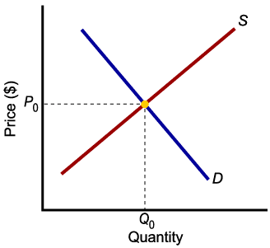
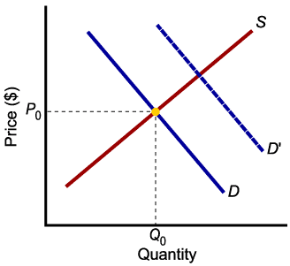
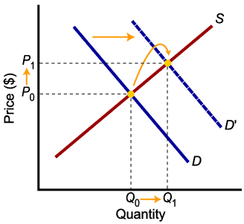

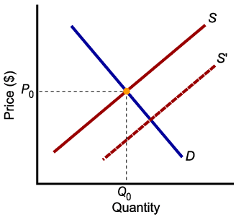
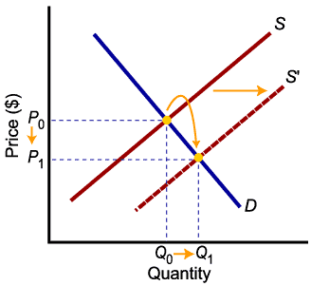
Increases in Demand and Supply
Higher demand leads to higher equilibrium price and higher equilibrium quantity.
Higher supply leads to lower equilibrium price and higher equilibrium quantity.

Slide 135

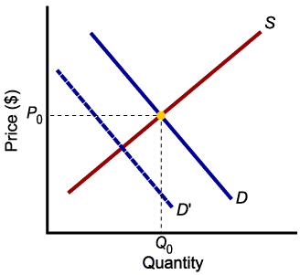
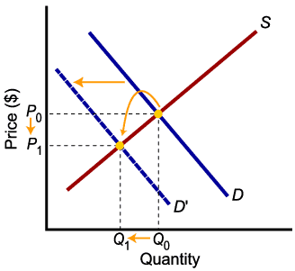

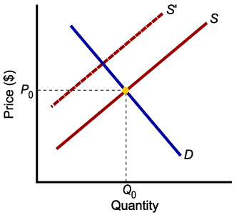
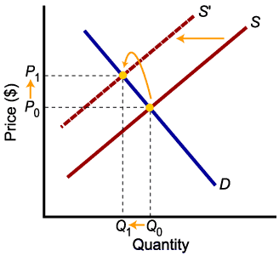
Decreases in Demand and Supply
Lower demand leads to lower price and lower quantity exchanged.
Lower supply leads to higher price and lower quantity exchanged.

